Slide 1
Loneliness in homebound older adults:
Integrative Literature Review
FCNI Research Article Discussion by Francesca C. Ezeokonkwo, Ph.D., RN
03/22/2022

Slide 2
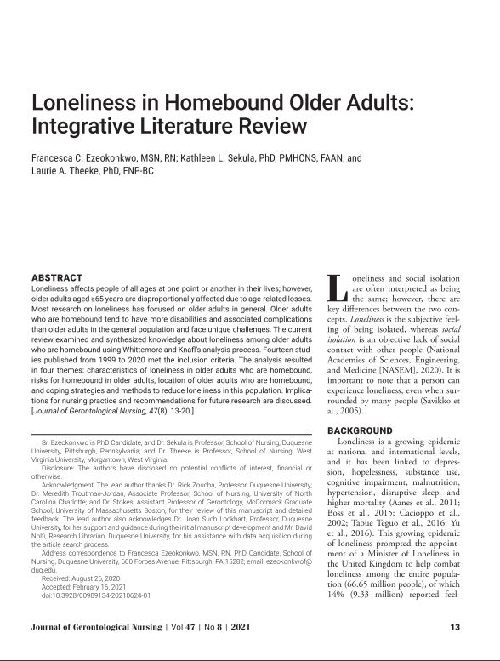
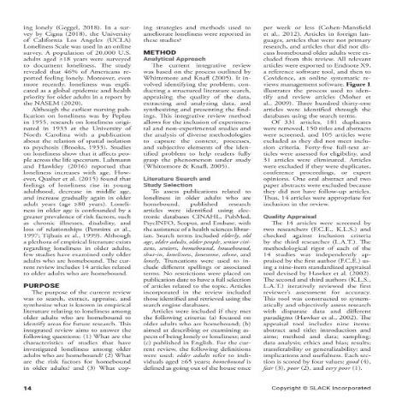
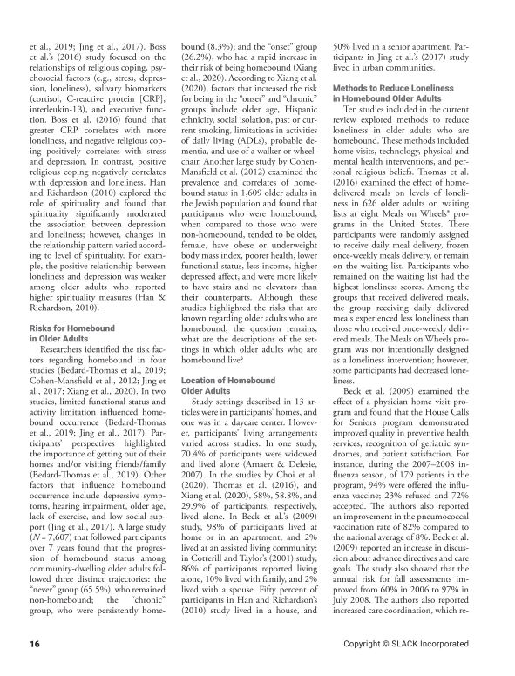
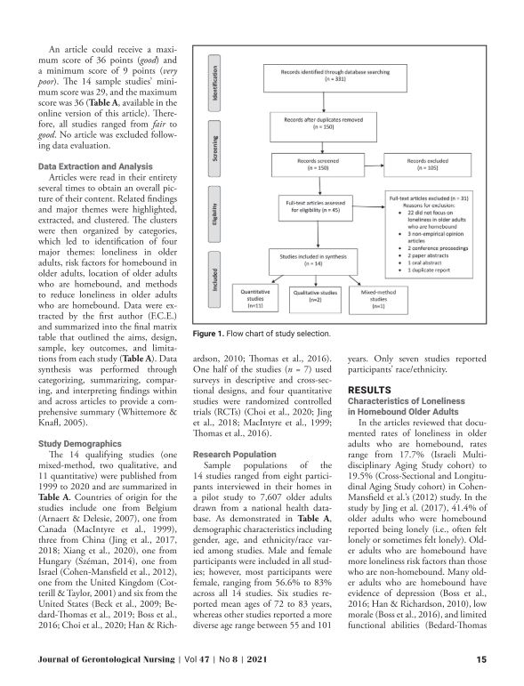
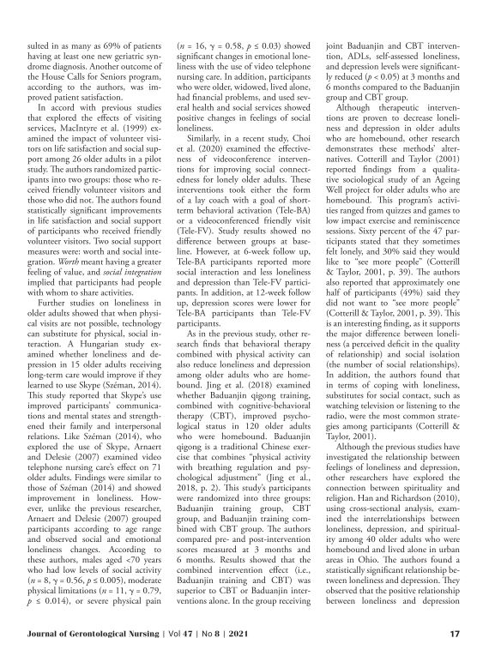
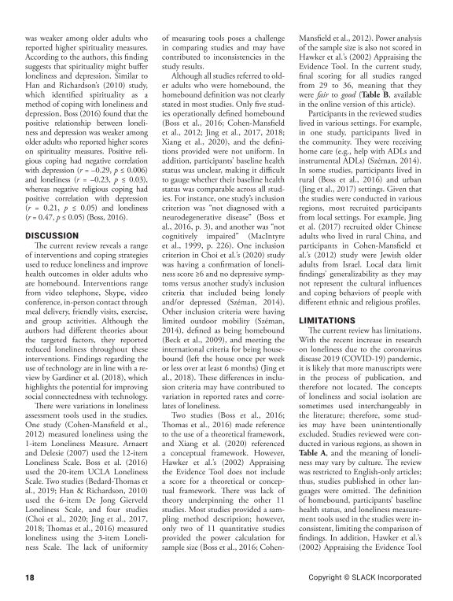
.

Slide 3
Why?
Detrimental effect on health
Limited research
Nurses' unique opportunity

Slide 4
What is LONELINESS
Subjective feeling
One’s desired level of social relationship not met
Note:
A person can be lonely in a crowd
A person can live alone and not be lonely or socially isolated

Slide 5
Loneliness vs. social isolation

Slide 6
Background
History of Research on loneliness
1933
Nursing literature 1955
Several studies
Have you ever felt lonely?
Affects people across the age spectrum
Rises in young adulthood
Decreases in middle age
Increases again in older age

Slide 7
Background
Growing epidemic
COVID -19 pandemic
International recognition as a public health issue
Ministers of Loneliness –
UK (2018)
Japan (2021)
46% of adults Americans reported being lonely (Cigna, 2018)
**58% reported being lonely (Cigna, 2021)***
Notes:
12% in 5 yrs

Slide 8
Background
Morbidity and mortality
Overall health risk compared to smoking & obesity
Physical and mental conditions:
cardiovascular disease
diabetes
stroke
dementia
hopelessness
depression
immune and respiratory illnesses

Slide 9
Background
Loneliness affects people across all developmental stages
Older adults are at great risk
Chronic illnesses
disabilities
loss of family & friends

Slide 10
PURPOSE
To synthesize literature relating to loneliness among older adults who are homebound
Evaluate the studies
Identify areas for future research
Notes:
So our article was an integrative literature review
This IR was guided by Whittemore and knafl analysis process which ….
The purpose of the .. to search, extract, appraise, and synthesize what is known about loneliness in older adults who are homebound
Evaluate strengths and weaknesses of the studies
Identify areas for future research.

Slide 11
Research Questions
What are the characteristics of studies that have investigated loneliness among older adults who are homebound?
1
What are the risk factors for homebound in older adults?
2
What coping strategies to reduce loneliness were reported in these studies?
3

Slide 12
Analytical Approach
Whittmore and Knafl (2005) 5 step method:
Problem identification
Literature search
Study appraisal
Extraction and analysis
Synthesis and presentation

Slide 13
Search Strategy
Five databases
CINAHL, PubMed, PsychINFO, Scopus, and Embase
Search terms:
Older adults, elderly, old age, older people, seniors, senior citizens
homebound, housebound, shut-in
loneliness, lonesome, alone, and lonely.
Use of Truncations
No restriction on publication date

Slide 14
EXCLUSION
Inclusion and Exclusion criteria
INCLUSION
Focused on older adults who are homebound;
Describe or examine aspects of being lonely or loneliness
English
Primary research
Studies outside and within US
Foreign languages
Not primary research, and
Articles that did not discuss homebound older adults

Slide 15
Study Selection
331 articles
Duplicates removed
150 titles screened
45 Full text articles assessed for eligibility
Two research team members
Final 14 articles
All research members agreed on final set of articles

Slide 16
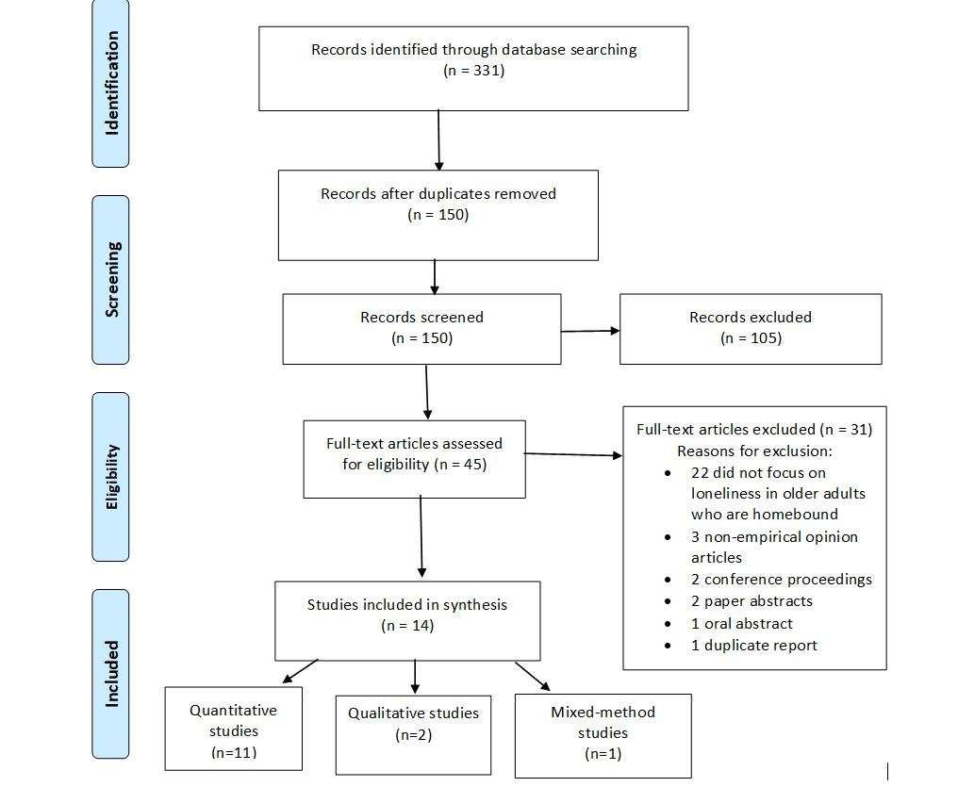
PRISMA Diagram

Slide 17
Quality Appraisal
9 – item appraisal tool (Hawker et al., 2002)
abstract and title; introduction and aims; method and data; sampling; data analysis; ethics and bias; results; transferability or generalizability; and implications and usefulness.
Each section is scored by four values: good - very poor
1st author appraisal reviewed by 2nd & 3rd authors
Maximum score of 36 points
Scores: 29 - 36
No article elimination
Theoretical framework: 3 articles

Slide 18
Study Demographics
11 quantitative, two qualitative, One mixed-method
Published from 1999 to 2020
7 countries
Research Population
8 to 7,607 older adults
Age range 55-101
Mostly female
Most collected data via surveys
4 studies - randomized control trials
7 studies - descriptive & cross-sectional designs
Belgium, Canada, Hungary, Israel, UK (1 each); China (3); US (6)

Slide 19
RESULTS
Characteristic of loneliness in older adults
Risk factors for homebound
Location of older adults who are homebound
Methods to reduce loneliness in older adults who are homebound

Slide 20
Results cont.
Characteristics of loneliness in homebound older adults
Lonelier and more loneliness risk factors
Evidence of depression, low morale, and limited functional abilities
Positive religious coping -> negative correlation with depression and loneliness
Higher score on spirituality measures, lower loneliness, and depression

Slide 21
Results cont.
Risk factors for homebound in older adults
Limited functional status
Activity limitation
Depressive symptoms
Hearing impairment
Being old
Lack of exercise and
Low social support

Slide 22
Results cont.
Location of older adults who are homebound
Study settings:
13 studies in the participant’s homes
One in a daycare center
Living alone: 58% – 98%
Widowed
Live with family and spouse
Assisted living community
House, apartment, urban communities

Slide 23
Results cont.
Methods to reduce loneliness in older adults who are homebound
Home visits
Home-delivered meals
Physician home visit programs
Friendly volunteer visitors
Technology
Skype, video telephone, and videoconference
Watching television or listening to the radio
Physical and mental health interventions
Cognitive Behavioral Therapy (CBT), low impact & breathing exercise
Quizzes and games, and reminiscence sessions
Personal religious beliefs

Slide 24
Limitations
Interchangeable use of Loneliness vs social isolation
Studies conducted in various regions; meaning of loneliness may vary by culture
English-only articles; studies in other languages.
Inconsistencies:
definition of homebound
participants’ baseline health status
loneliness measurement tools
Convenience samples
Few studies included control or comparison groups

Slide 25
Research Gaps
Variation in loneliness measures
Inconsistencies in the homebound definition
Use and benefit of technology
Role of spirituality and religiosity

Slide 26
Practice Implications
Conduct
Conduct periodic assess­ment using validated
loss of a significant relationship
geographic move,
relevant health conditions
Discuss
Discuss the adverse health outcomes
Connect
Determine
Determine any underlying causes
e.g., hearing loss, mobility limitations
Connect isolated or lonely older adults with needed social care

Slide 27
Conclusion
Loneliness has significant detrimental effects on health
Older adults often face physical and psychosocial difficulties as they age
Older adults who are homebound experience more loneliness
Nurses should access older adults for loneliness with every encounter.
Nurses should pay particular attention and conduct thorough loneliness assessments using a standardized tool.
Nurses are in an important position to assess for and recognize loneliness in those who are homebound and ensure that patients receive appropriate care and treatment.

Slide 28
Reference
Ezeokonkwo, F. C., Sekula, K. L., & Theeke, L. A. (2021). Loneliness in Homebound Older Adults: Integrative Literature Review. Journal of Gerontological Nursing, 47(8), 13-20. https://doi.org/doi:10.3928/00989134-20210624-01
Notes:
Here’s the article reference.

